Slide 1
Capstone Project
Seoul Bike Sharing Demand Prediction
Team Members:- 1) Umang Wasekar

Slide 2
CONTENTS
INTRODUCTION
PROBLEM STATEMENT
DATA SUMMARY
FEATURE ANALYSIS
EDA
ALGORITHMS IMPLEMENTATION
CONCLUSION

Slide 3
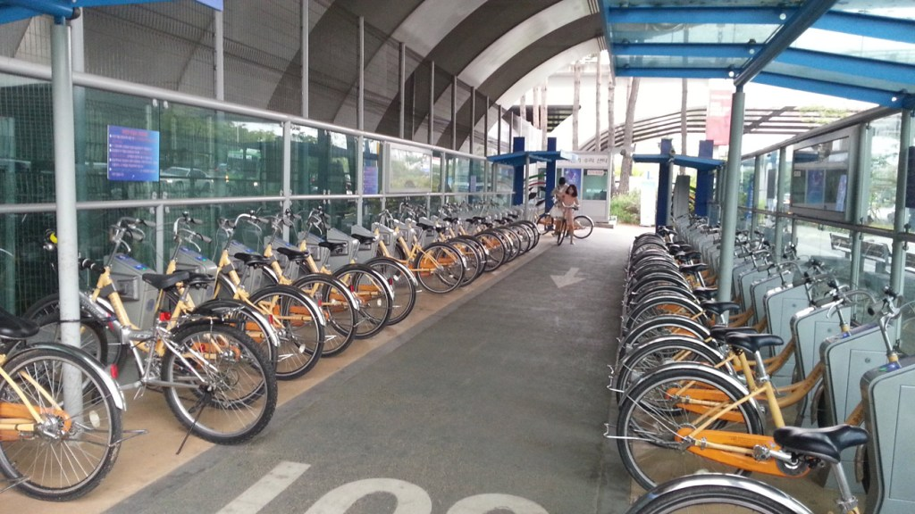

Slide 4
PROBLEM STATEMENT

Slide 5
Problem Statement
Bike rentals have became a popular service in recent years and it seems people are using it more often. With relatively cheaper rates and ease of pick up and drop at own convenience is what making this business thrive.
Mostly used by people having no personal vehicles and also to avoid congested public transport which that’s why they prefer rental bikes.
Therefore, the business to strive and proﬁt more, it has to be always ready and supply no. of bikes at different locations, to fulﬁl the demand.
Our project goal is a pre planned set of bike count values that can be a handy solution to meet all demands.

Slide 6
DATA SUMMARY

Slide 7
DATA SUMMARY
This Dataset contains 8760 lines and 14 columns.
Three categorical features ‘Seasons’, ‘Holiday’, & ‘Functioning Day’.
One Datetime features ‘Date’.
We have some numerical type variables such as temperature, humidity, wind, visibility, dew point temp, solar radiation, rainfall, snowfall which tells the environment conditions at that particular hour of the day.

Slide 8
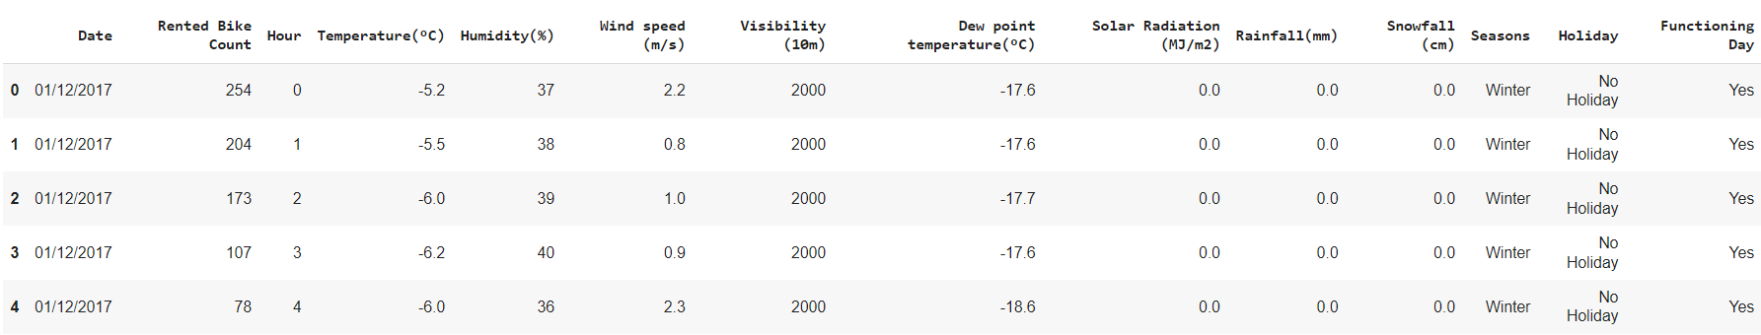
DATA SNAPSHOT

Slide 9
FEATURE ANALYSIS

Slide 10
FEATURE SUMMARY
Date : Year-Month-Day
Rented Bike Count - Count of bikes rented at each hour
Hour - Hour of the day
Temperature - Temperature in Celsius
Humidity - %
Wind Speed - m/s
Visibility - 10m
Dew point temperature -Celsius
Solar radiation -MJ/m2
Rainfall -mm
Snowfall -cm
Seasons -Winter, Spring, Summer, Autumn
Holiday -Holiday/No Holiday
Functional Day - NoFunc(Non Functional Hrs),Fun(Functional Hrs)

Slide 11
DATA INSIGHTS
There are No Missing Values present
There are No Duplicate values present
There are No null values.
And ﬁnally we have 'rented bike count' variable which we need to predict for new observations
The dataset shows hourly rental data for one year (1 December 2017 to 31 November(2018)(365 days).we consider this as a single year data
So we convert the "date" column into 3 different column i.e "year","month","day".

Slide 12
EDA

Slide 13
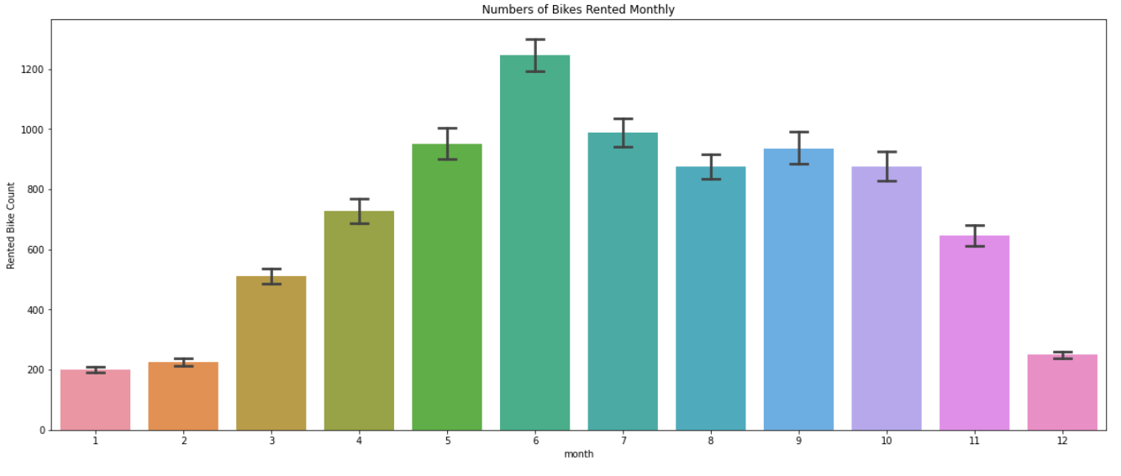
MONTH WISE ANALYSIS
The plot besides depicts the monthly demand for Rented Bikes.
The demand is highest in the month of June followed by July, whilst it is lowest in the month of Jan, Feb and December.
Overall, demand is highest between the month of May and October.

Slide 14
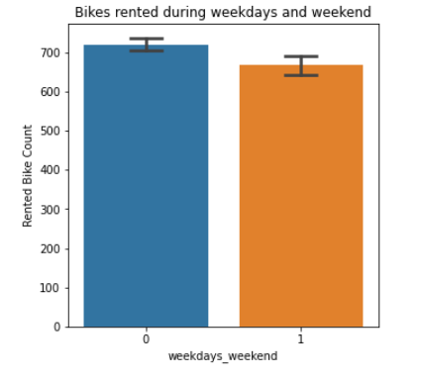
WEEKDAYS AND WEEKEND DEMAND ANALYSIS
The plot besides shows weekdays and weekend demand for Rented Bikes.
It can be seen that there isn’t much difference in demand during weekdays and weekend.
Although, weekday demand is slightly higher compared to weekend.

Slide 15
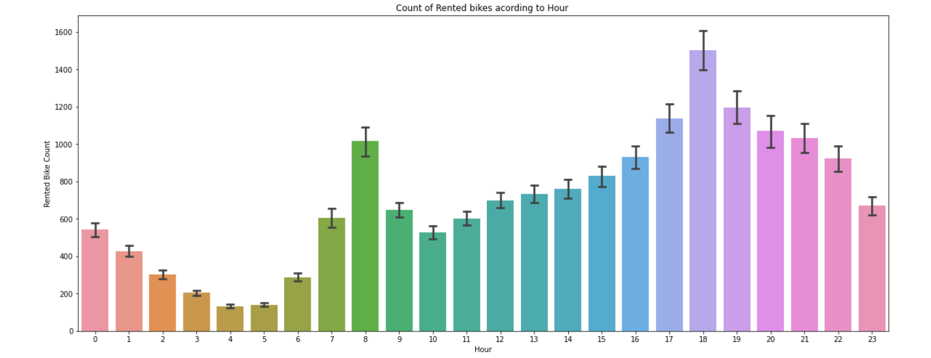
HOUR WISE ANALYSIS

Slide 16
HOUR WISE ANALYSIS
The above plot depicts the Hourly demand of Rented Bikes in a day.
The demand of Rented Bikes is peaked during 7am to 9 am and 7 pm to 9 pm.
This demand must be because commute hours of the working professionals.

Slide 17
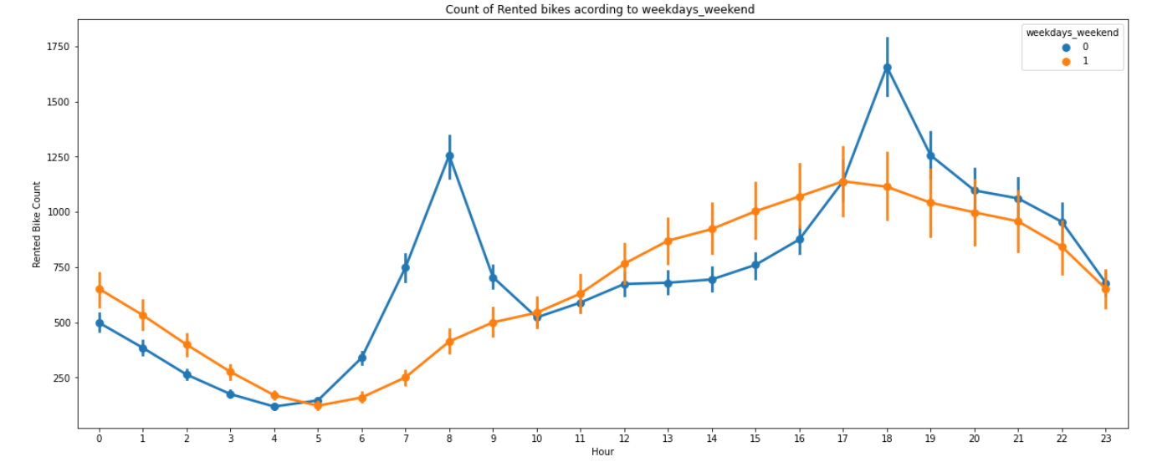
FUNCTIONING DAY ANALYSIS

Slide 18
FUNCTIONING DAY ANALYSIS
In the above point plot which shows the use of rented bike in functioning daya or not, and it clearly shows that,
Peoples dont use rented bikes on non-functioning day.

Slide 19
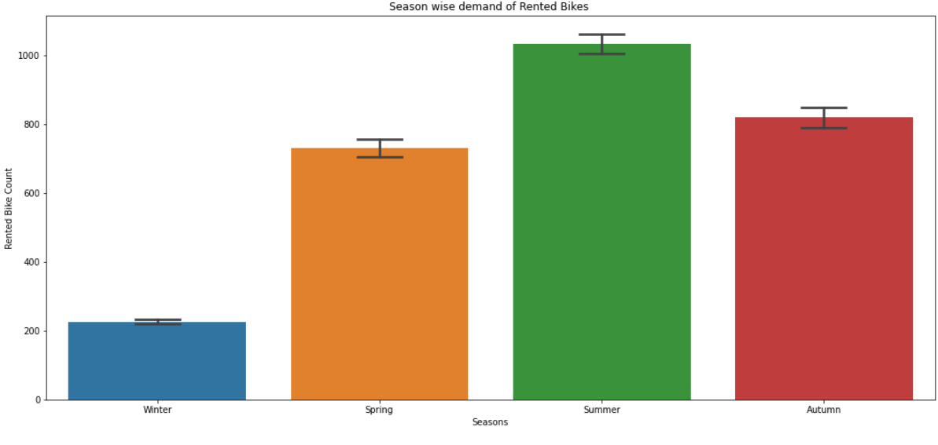
SEASON WISE ANALYSIS
This above bar plot shows the distribution of rented bike count season wise
And we can clearly see that that peoples love to ride bike in summer seasons and autumn season
But in winter season people don't take any rented bike due to because of snowfall

Slide 20
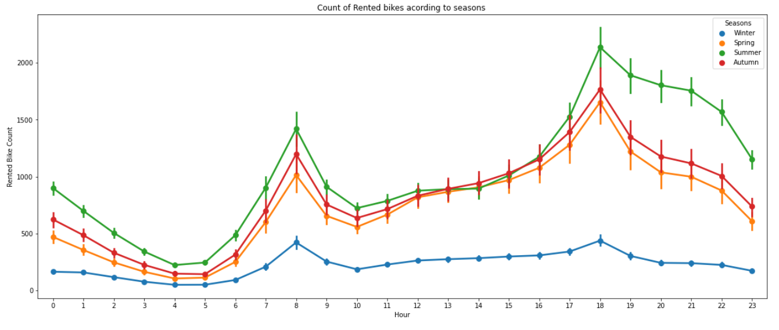
SEASON WISE ANALYSIS

Slide 21
SEASON WISE ANALYSIS
Demand for bike is most During Summer season, whilst this demand exponentially decreases in Winter.
7-9 during day and 5-7 in the evening are the hours where Bike demand is at the peak, this trend is common for almost all seasons.
This decline in demand during winter season maybe because of bad weather condition, heavy snowfall etc.

Slide 22
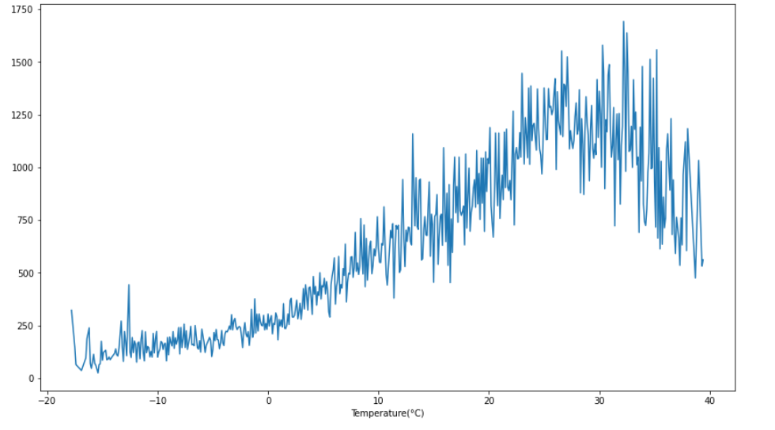
NUMERICAL DATA ANALYSIS (DV & IV CORRELATION)
It can be stated from the above plot that people usually rent bike when temperature is often between 25 - 26 on an average.

Slide 23
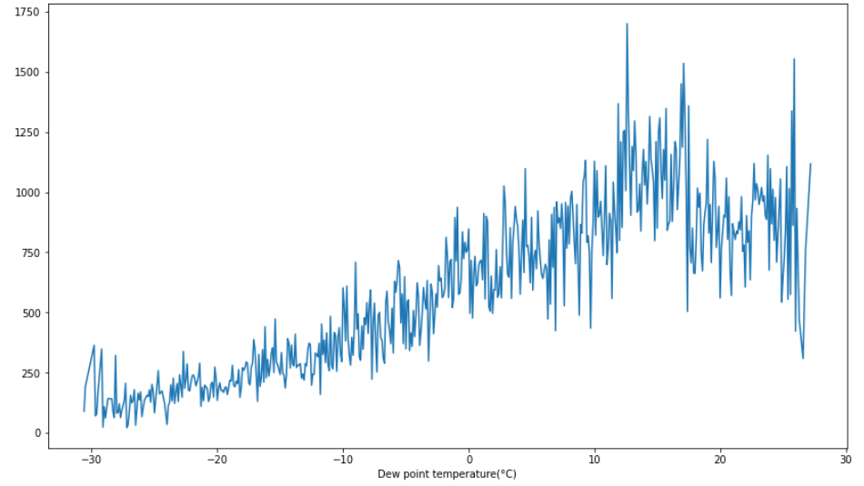
NUMERICAL DATA ANALYSIS (DV & IV CORRELATION)
Effect of dew on business is almost identical to that of temperature.

Slide 24
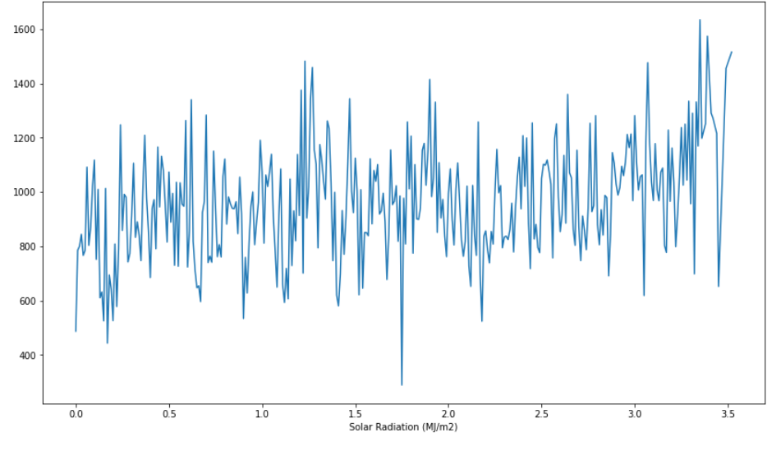
NUMERICAL DATA ANALYSIS (DV & IV CORRELATION)
From the above plot we can say that number of bikes rented gradually increases as solar radiation.

Slide 25
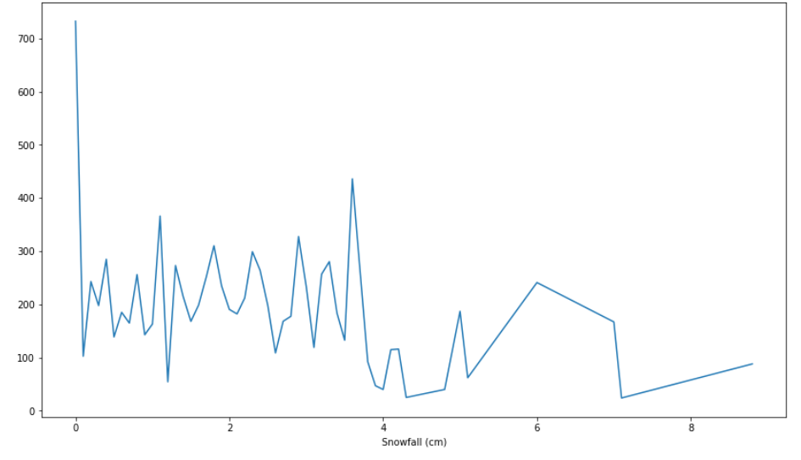
NUMERICAL DATA ANALYSIS (DV & IV CORRELATION)
It can be clearly seen that snowfall can heavily affect the business. Whenever, there is heavy snowfall i.e. above 4cm the amount of bikes rented drops.

Slide 26
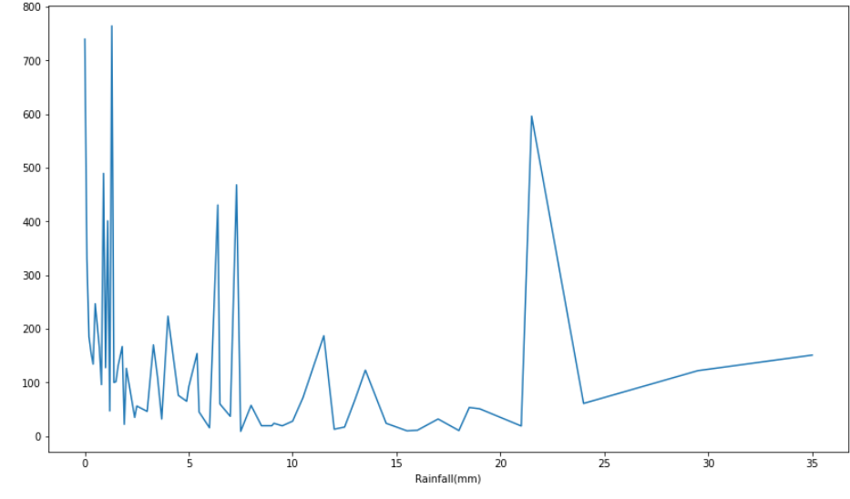
NUMERICAL DATA ANALYSIS (DV & IV CORRELATION)
From the above plot that even if it rains a lot the demand of of rent bikes is not decreasing, here for example even if we have 20 mm of rain there is a big peak of rented bikes.

Slide 27
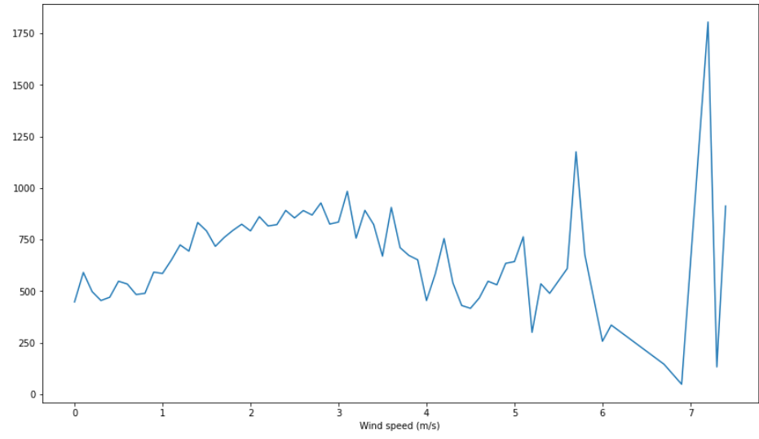
NUMERICAL DATA ANALYSIS (DV & IV CORRELATION)
Distribution of bike rented is almost uniform until the wind speed starts increasing above 6m/s and there is exponential rise in bike rented when the speed is 7 m/s

Slide 28
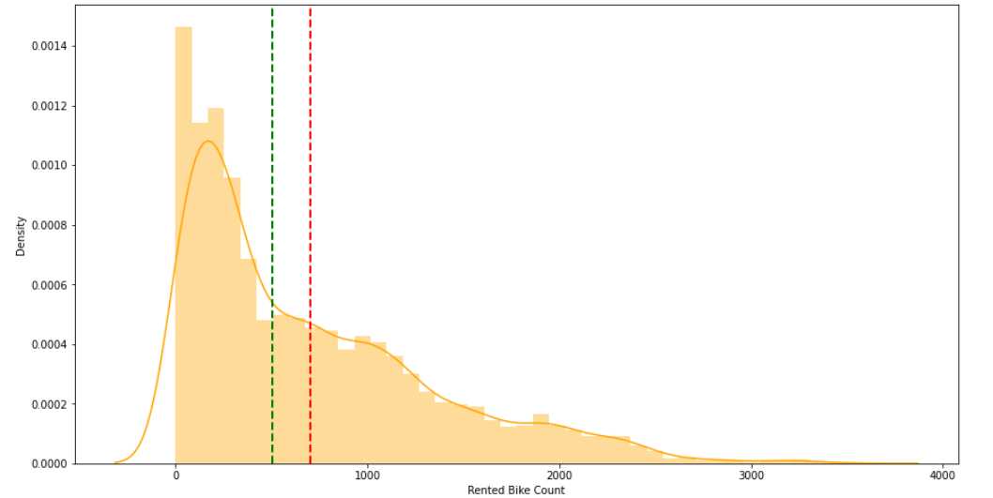
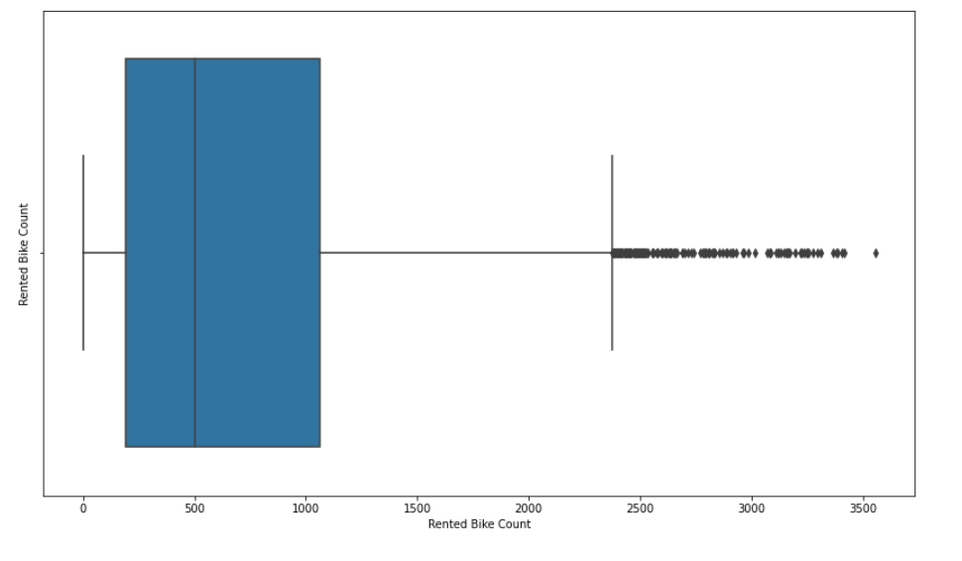
RENTED BIKE COLUMN ANALYSIS (BEFORE SQ.)

Slide 29
RENTED BIKE COLUMN ANALYSIS (BEFORE SQ.)
The above graph shows that Rented Bike Count has moderate right skewness.
The above boxplot shows that we have detect outliers in Rented Bike Count column
Since the assumption of linear regression is that 'the distribution of dependent variable has to be normal', so we should perform Square root operation to make it normal

Slide 30
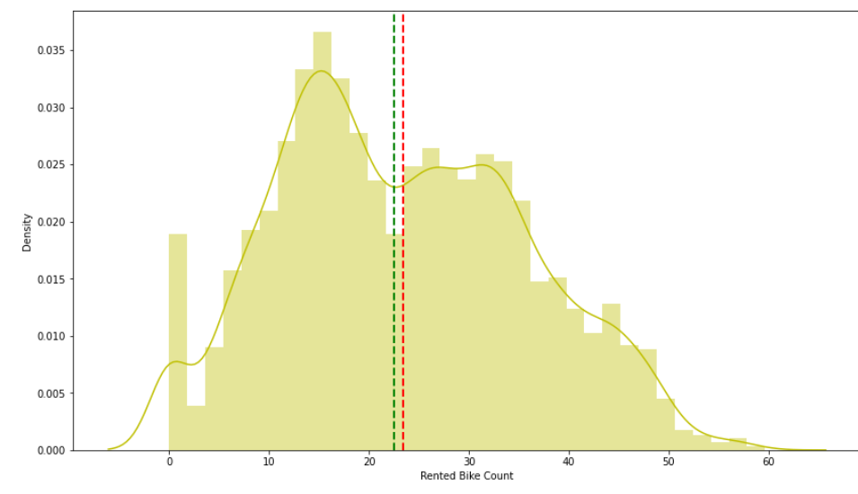
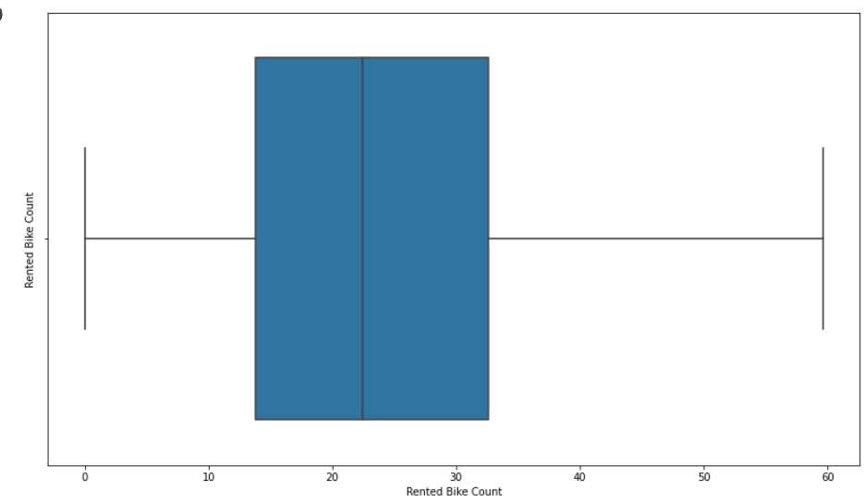
RENTED BIKE COLUMN ANALYSIS (AFTER SQ.)

Slide 31
RENTED BIKE COLUMN ANALYSIS (AFTER SQ.)
After applying Square root to the skewed Rented Bike Count, here we get almost normal distribution.
After applying Square root to the Rented Bike Count column, we ﬁnd that there is no outliers present

Slide 32
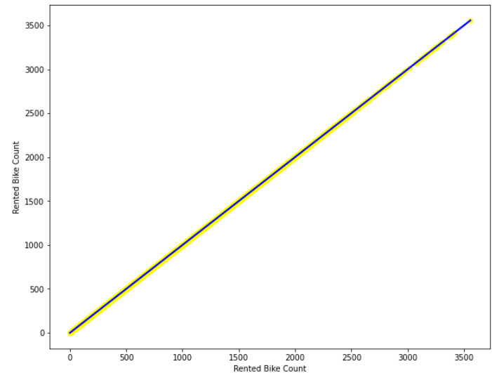
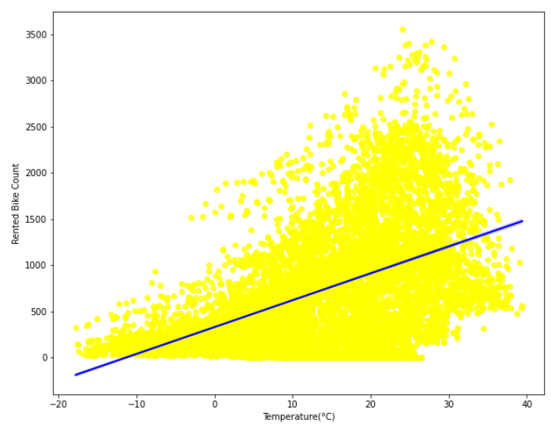
REGRESSION PLOT FOR NUMERICAL FEATURES

Slide 33
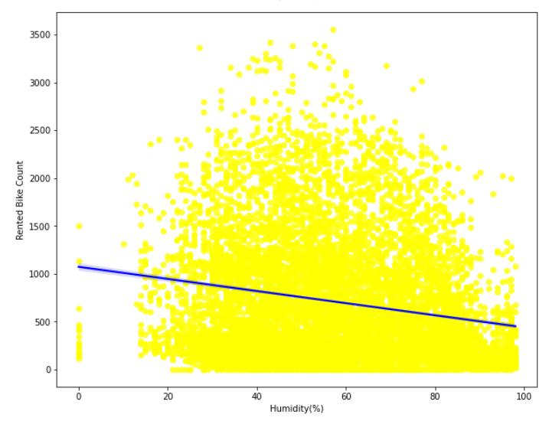
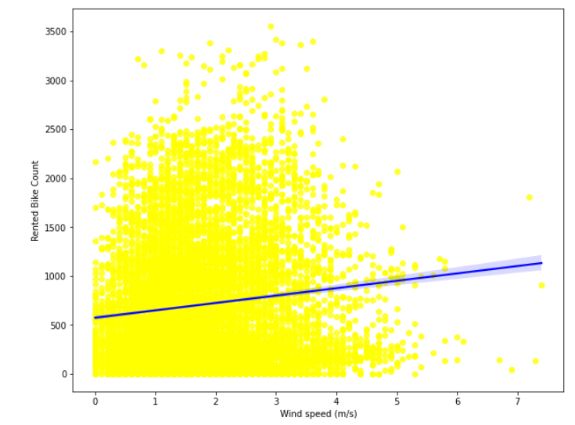
REGRESSION PLOT FOR NUMERICAL FEATURES

Slide 34
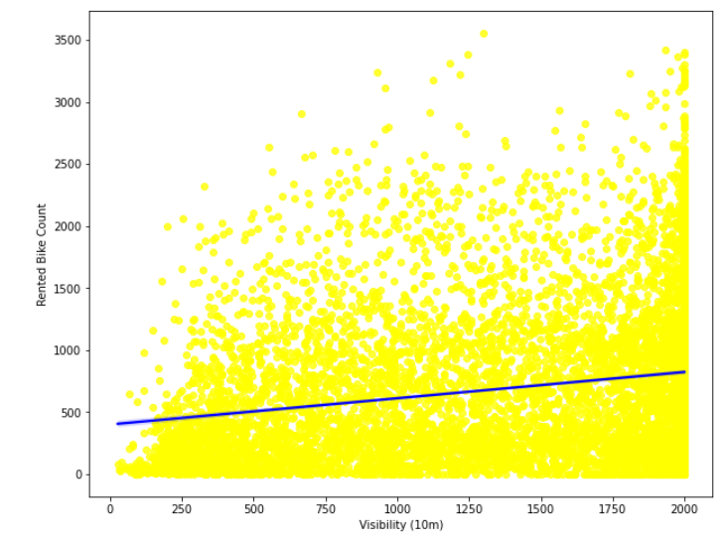
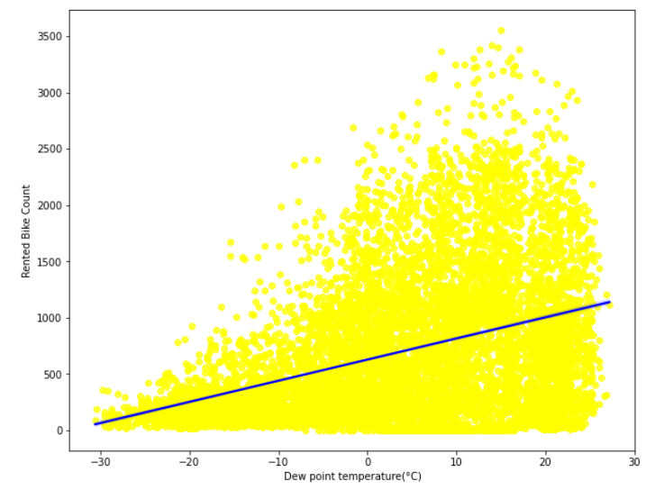
REGRESSION PLOT FOR NUMERICAL FEATURES

Slide 35
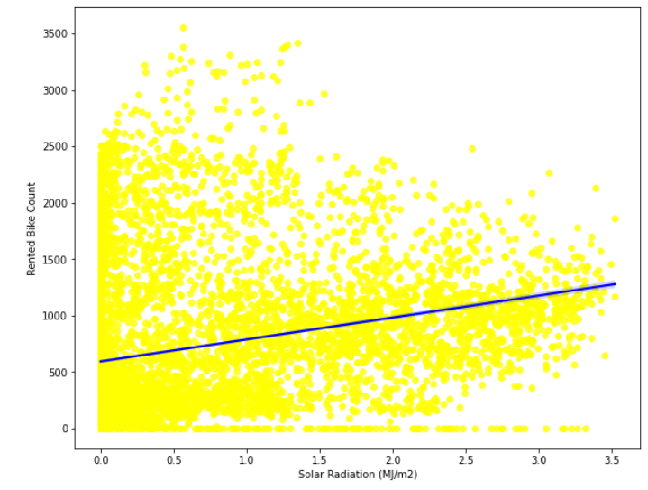
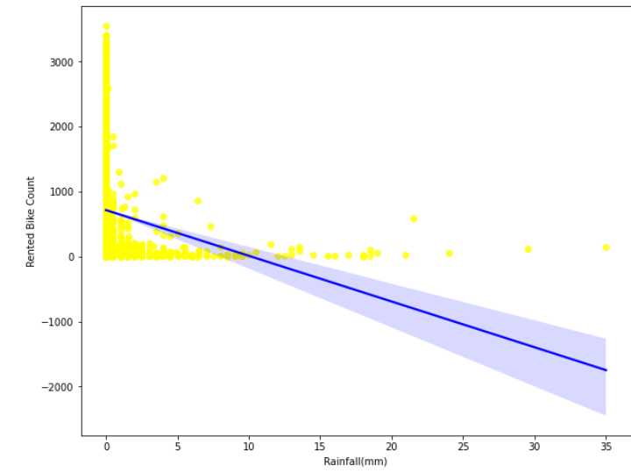
REGRESSION PLOT FOR NUMERICAL FEATURES

Slide 36
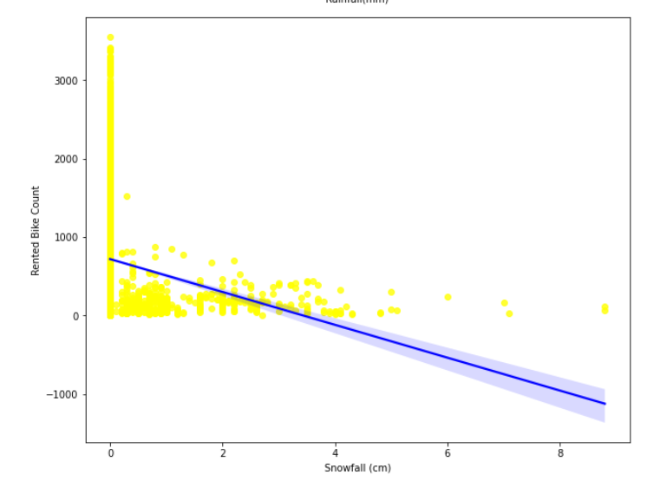
REGRESSION PLOT FOR NUMERICAL FEATURES

Slide 37
REGRESSION PLOT NUMERICAL FEATURES
From the above regression plot of all numerical features we see that the columns 'Temperature', 'Wind_speed','Visibility', 'Dew_point_temperature', 'Solar_Radiation' are positively relation to the target variable.
which means the rented bike count increases with increase of these features.
'Rainfall’, 'Snowfall’, 'Humidity' these features are negatively related with the target variable which means the rented bike count decreases when these features increase.

Slide 38
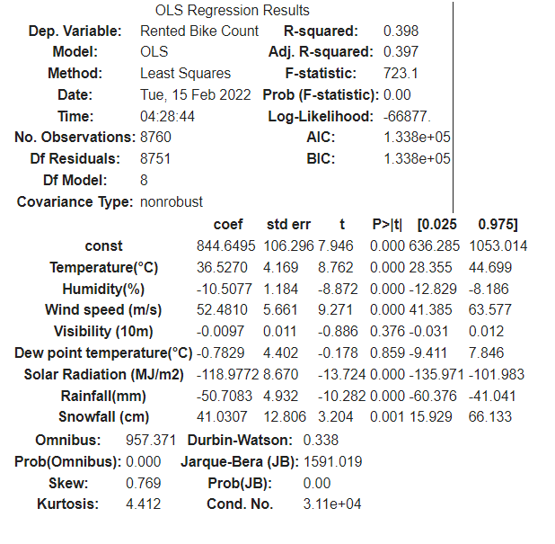
OLS REGRESSION MODEL
R square and Adj Square are near to each other. 40% of variance in the Rented Bike count is explained by the model.
P value of dew point temp and visibility are very high and they are not signiﬁcant.

Slide 39
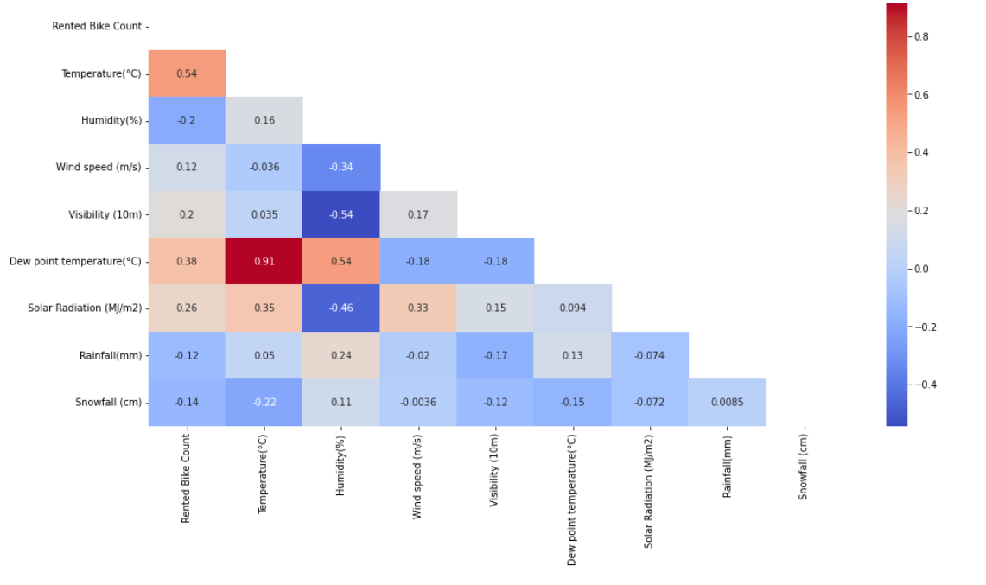
CORRELATION MATRIX

Slide 40
CORRELATION MATRIX
By studying the above plot we can say that Dew point temperature , Solar Radiation as well as Temperature are positively related to Target variable. This means if any of these variable increases the Target variable will also increase.
While, Humidity and Rainfall are negatively correlated meaning that Target variable will decrease with increase in these variables.
From the above correlation heatmap, We see that there is a positive correlation between columns 'Temperature' and 'Dew point temperature' i.e 0.91 so even if we drop this column then it dont affects the outcome of our analysis. And they have the same variations.. so we can drop the column 'Dew point temperature(°C)'.

Slide 41
MODEL BUILDING ALGORITHM IMPLEMENATION

Slide 42
MODEL BUILDING
LINEAR REGRESSION
LASSO REGRESSION
RIDGE REGRESSION
DECISION TREES REGRESSOR
RANDOM FOREST REGRESSOR
GRADIENT BOOSTED REGRESSOR
GRADIENT BOOSTING REGRESSOR WITH GRIDSEARCHCV

Slide 43
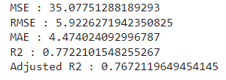
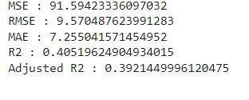
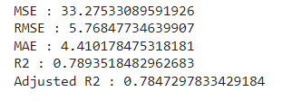
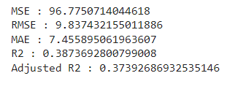
MODEL BUILDING
LINEAR REGRESSION
TRAINING SET
TESTING SET
LASSO REGRESSIONR
TRAINING SET
TESTING SETIDGE

Slide 44
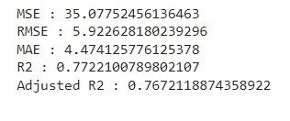
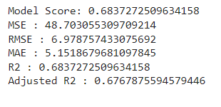
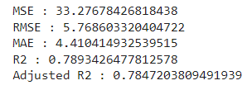
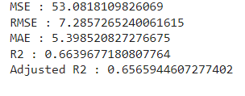
MODEL BUILDING
RIDGE REGRESSION
TRAINING SET
TESTING SET
DECISION TREE
TRAINING SET
TESTING SETIDGE

Slide 45
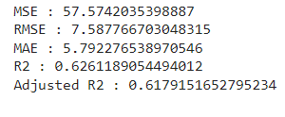
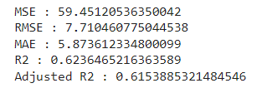
MODEL BUILDING
ELASTIC NET
TRAINING SET
TESTING SET

Slide 46
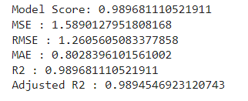
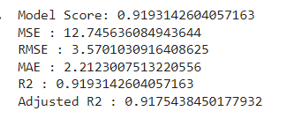
RANDOM FOREST
TRAINING SET TESTING SET

Slide 47
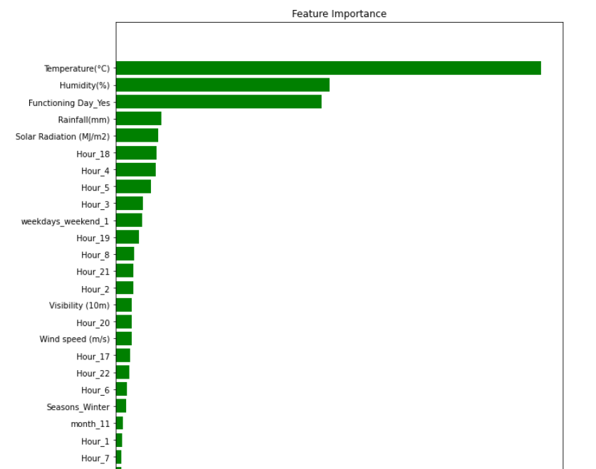
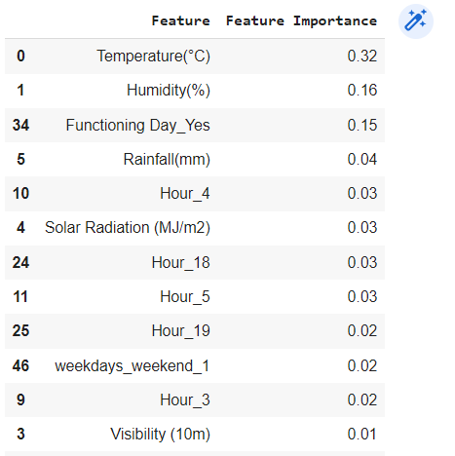
RANDOM FOREST

Slide 48
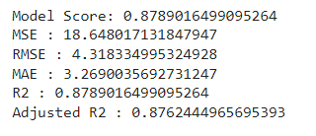
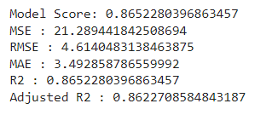
GRADIENT BOOST
TRAINING SET TESTING SET

Slide 49
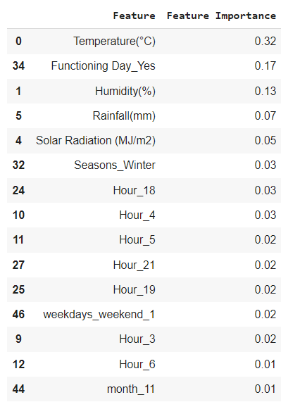
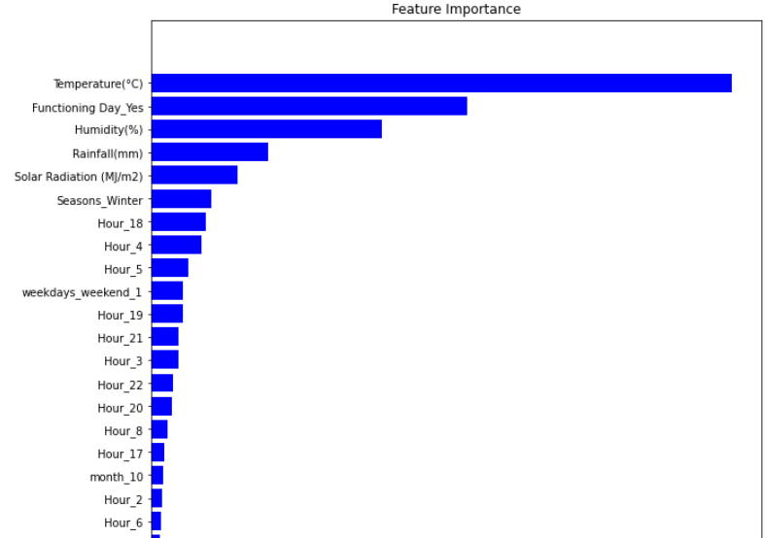
GRADIENT BOOST

Slide 50
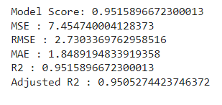
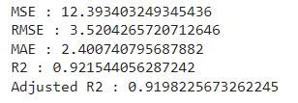
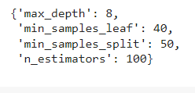
GRADIENT BOOSTING WITH GRIDSEARCH CV
TRAINING SET TESTING SET
HYPERPARAMETERS

Slide 51


GRADIENT BOOSTING WITH GRIDSEARCH CV

Slide 52
CHALLENGES
Large Dataset to handle.
Numerous graph plots needed for analysis
Feature engineering
Feature selection
Optimizing the model
Carefully tuned Hyperparameters as it affects the R2 score.

Slide 53
CONCLUSION
‘Hour’ of the day holds the most important feature.
Bike rental count is mostly correlated with the time of the day as it is peak at 10 am morning and 8 pm at evening.
We observed that bike rental count is high during working days than non working day.
We see that people generally prefer to bike at moderate to high temperatures, and when little windy
It is observed that highest number bike rentals counts in Autumn & Summer seasons & the lowest in winter season. We observed that the highest number of bike rentals on a clear day and the lowest on a snowy or rainy day. We observed that with increasing humidity, the number of bike rental counts decreases.

Slide 54

CONCLUSION
When we compare the root mean squared error and mean absolute error of all the models, Random forest Regressor and Gradient Boosting GridSearchCv gives the highest R2 score of 99% and 95% respectively for Train Set and 92% for Test set. So, ﬁnally this model is best for predicting the bike rental count on daily basis.

Slide 55
THANK YOU!

